Slide 1
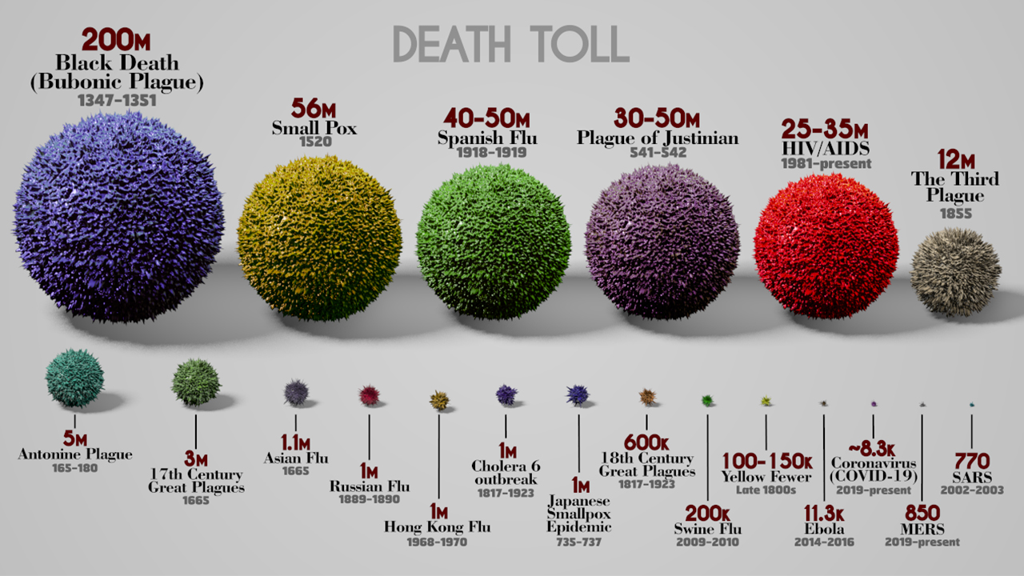

Slide 2


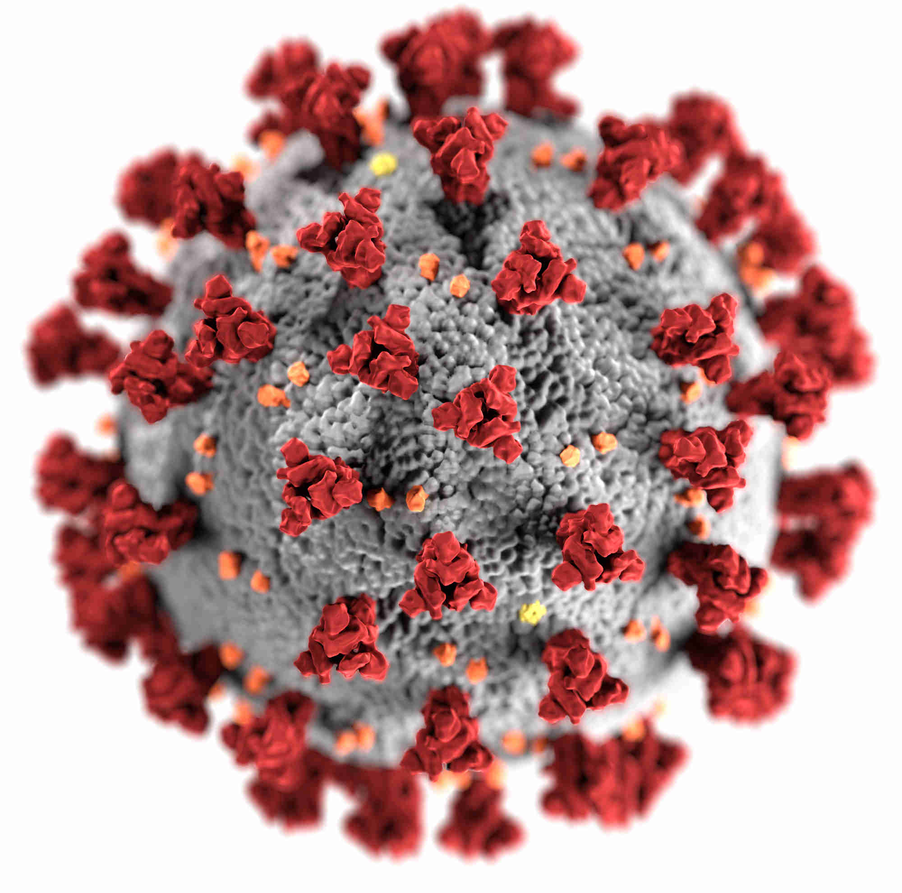


Covid-19 Action Plan

Slide 3






Project Information
Project Id - team-assignment-1-330904
Dataset - Data
Dashboard - Link
Video Presentation - Youtube

Slide 4

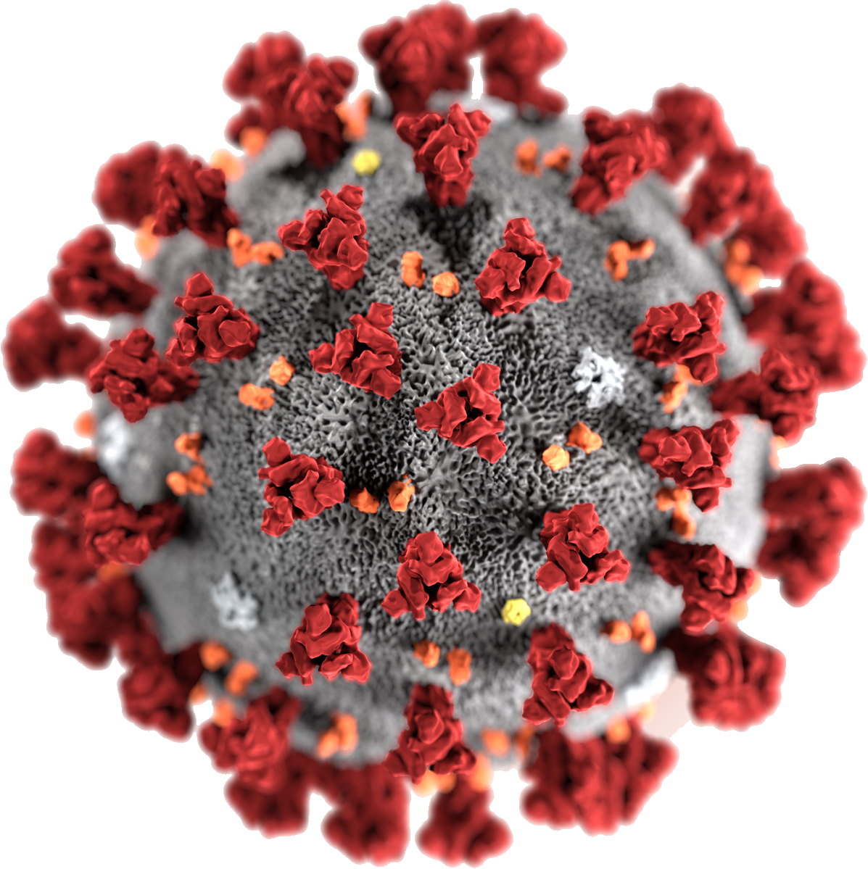


Problem Statement
Influencing Factors
Analyze effects of factors on the spread of COVID-19 in the USA.
Public Policy
Identity suggestions for pandemic policies for government.
Sentiment Analysis
Identify public mood through twitter data
Government Measures
Access the efficacy of measures to prevent covid

Slide 5
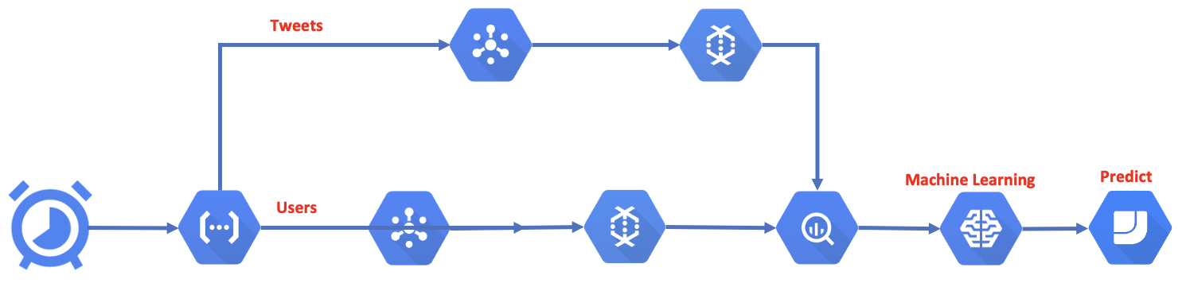
Process Overview

Slide 6
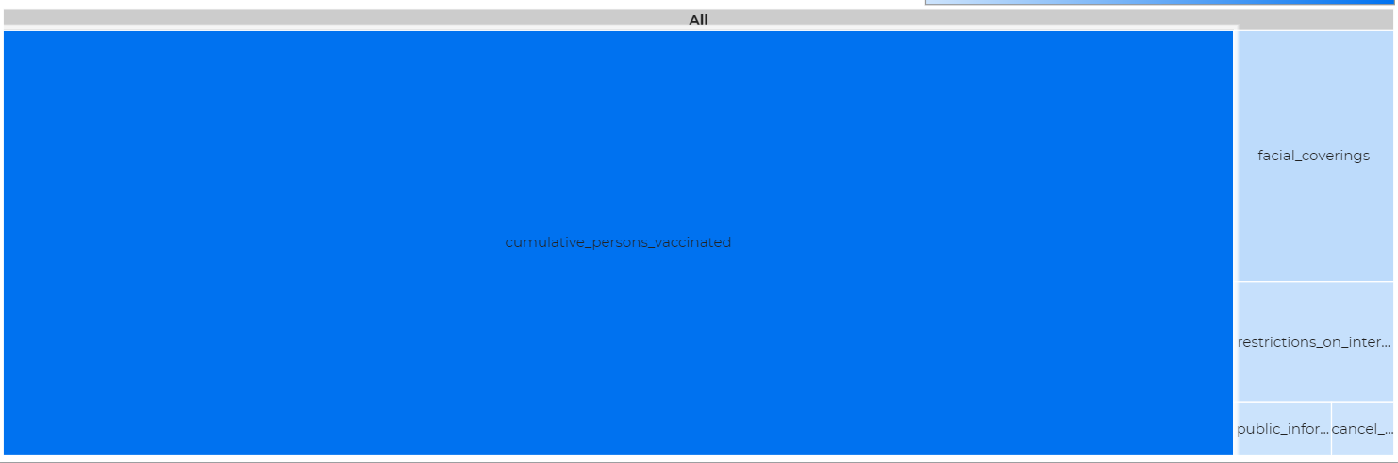
Effectiveness of Measures to curb spread of Covid-19
Effectiveness of Measures to curb spread of Covid-19

Slide 7
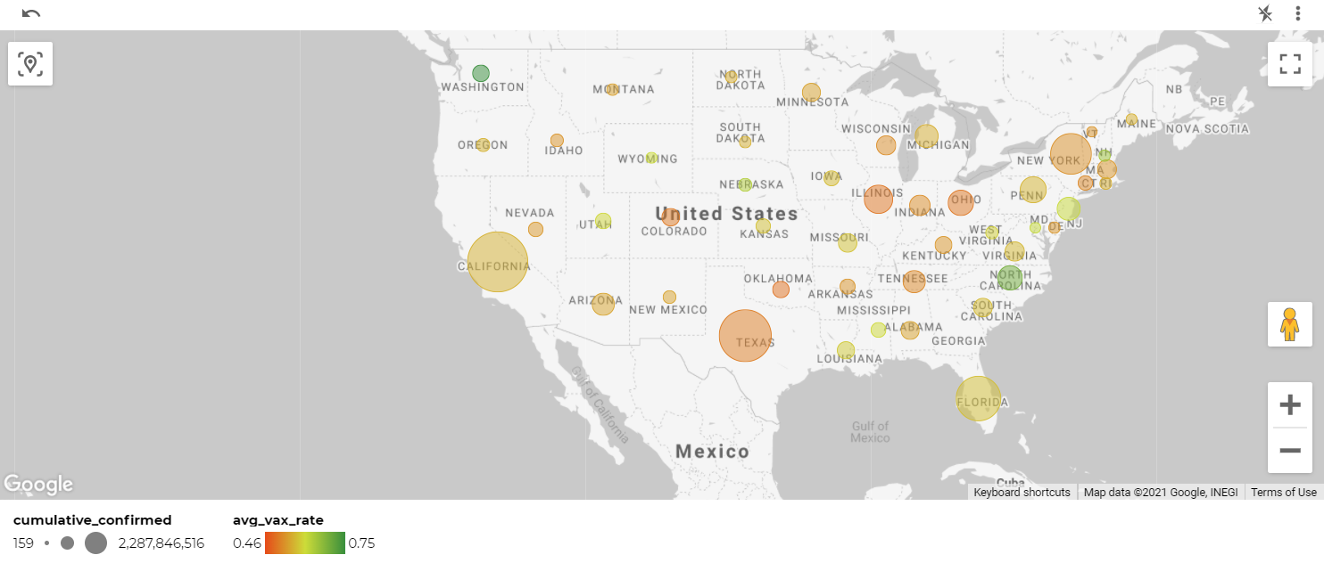
Areas Of Focus

Slide 8
Talks Around Vaccine
Negative
Doubts effectiveness
Too many dozes wont help
Positive
Proof on vaccination required for outdoor utilities.
Protest against vaccines due to mandate
vaccination mandates at workplace
Effectiveness of 3rd doze moderna vaccine

Slide 9
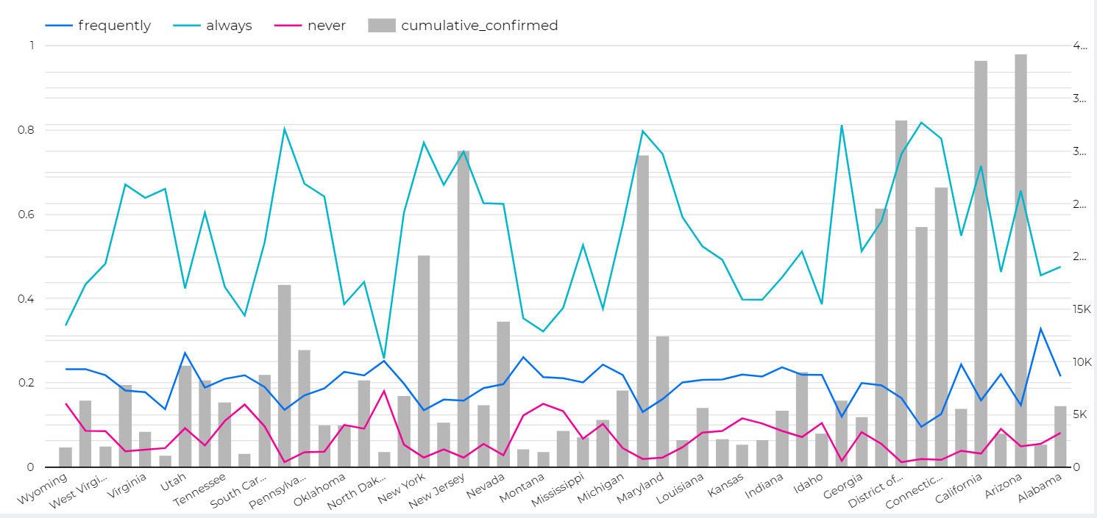
Mask Adoption Rates
Mask adoption rate

Slide 10
Negative
Against mask mandate and social distancing
Against covid restrictions in indoor public places
Positive
People are recommended to wear masks outdoors
Talks about getting boosters shots in order to stop wearing masks
Talks Around Masks

Slide 11
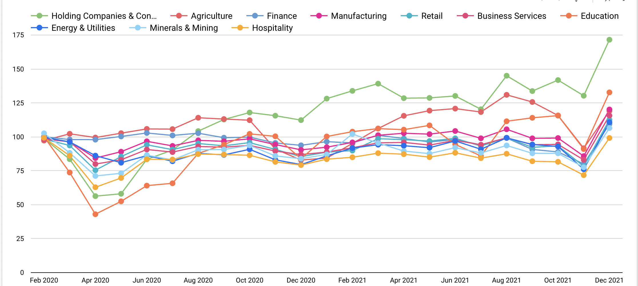
Impact on Industries

Slide 12
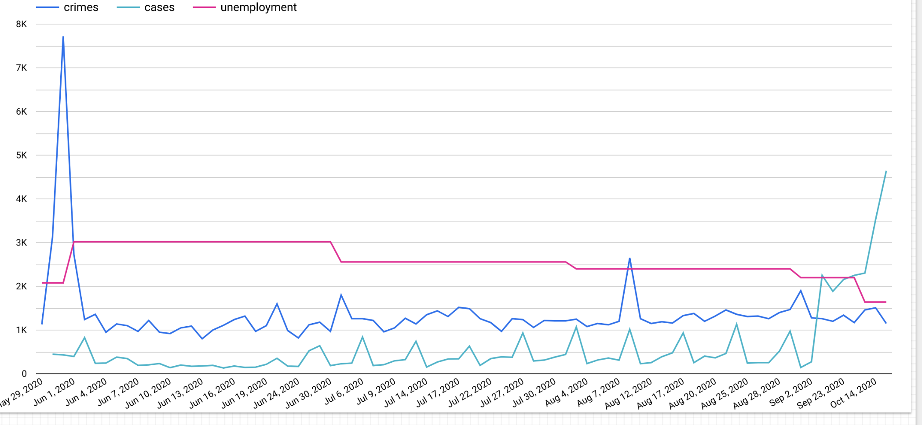
Myth vs Realities

Slide 13
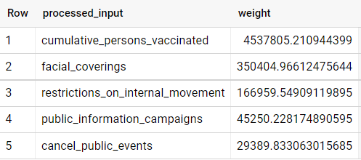
Top 5 Effective Measures to curb spread of Covid-19

Slide 14



Sentiment Analysis
Sentiment Analysis
15%
Mask
85%
Tweets
13%
Vaccine
4876
87%
20%
Omicron
80%
76%
24%
66%
Government
34%

Slide 15
Recommendations
1
Increase support for Hospitality, Education and Energy industries.
Industries
2
Create mask mandates in public places
Mandates
3
More investment on awareness campaigns to increase vaccination rates
Awareness
Social Media
Tackle fake news and ensure clear communication with the public
4
5
Vaccine Passport
Mandate proof of vaccination for public places

Slide 16
Appendix

Slide 17
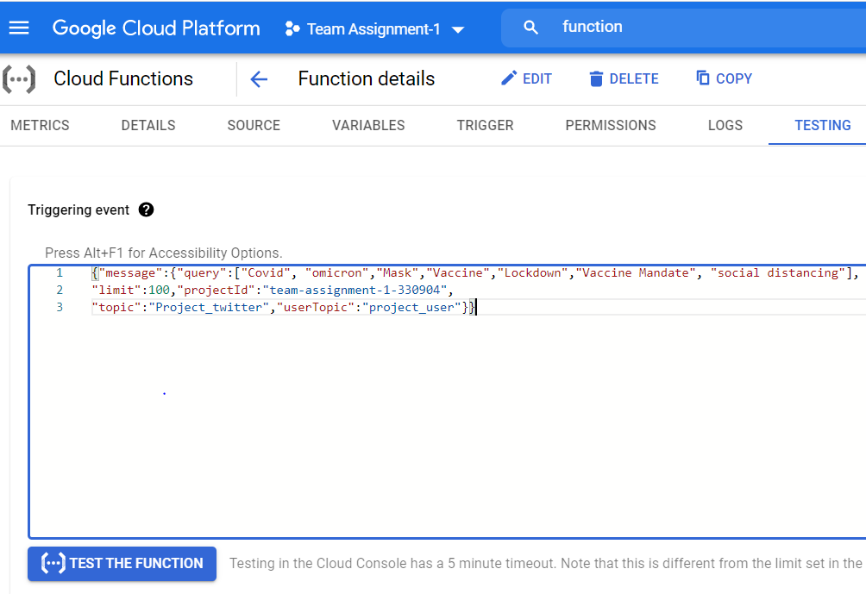
Cloud Function

Slide 18
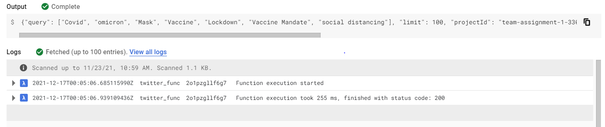
Cloud Function Testing
{"message":{"query":["Covid", "omicron","Mask","Vaccine","Lockdown","Vaccine Mandate", "social distancing"],
"limit":100,"projectId":"team-assignment-1-330904",
"topic":"Project_twitter","userTopic":"project_user"}}

Slide 19
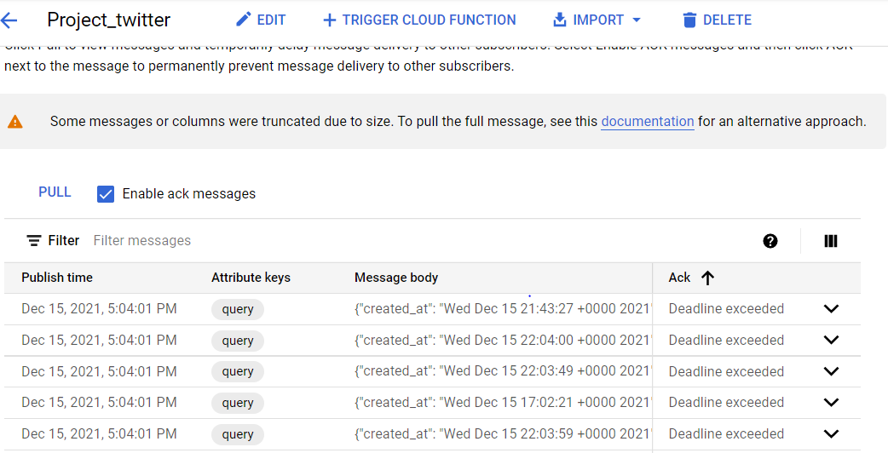
Cloud Function

Slide 20
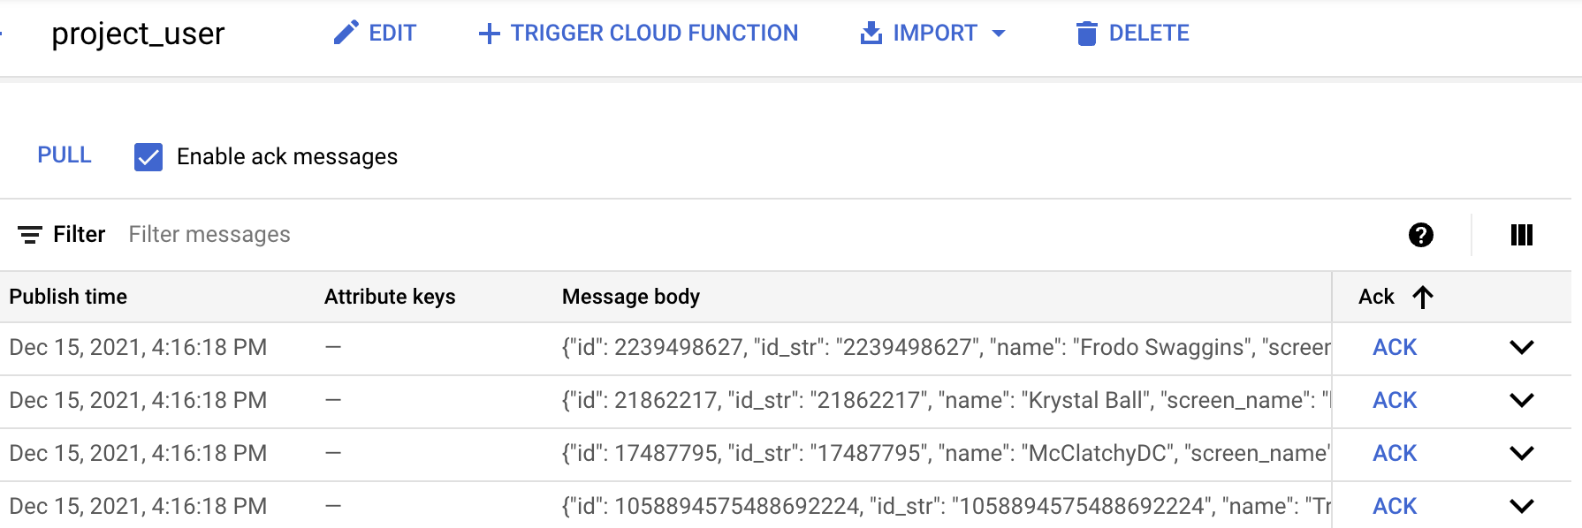
Pub/sub 2 (Users)
Cloud Function

Slide 21
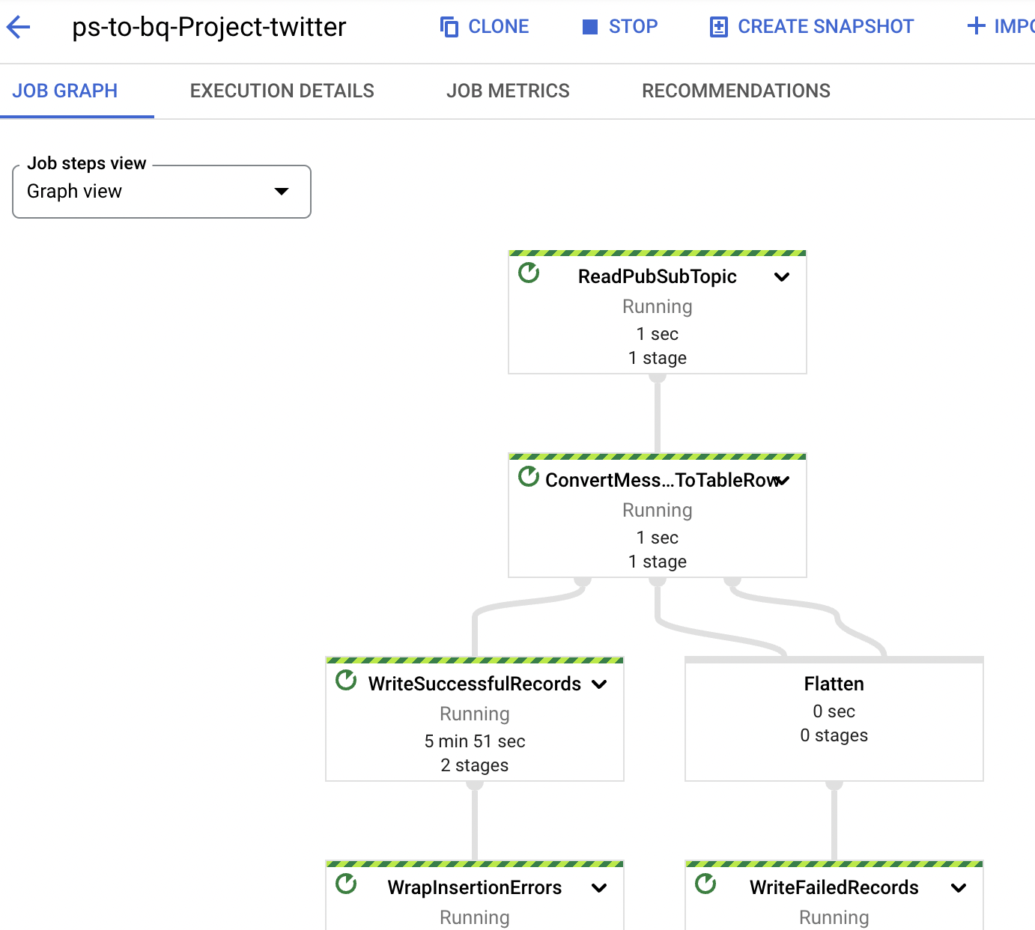
Pub-Sub

Slide 22
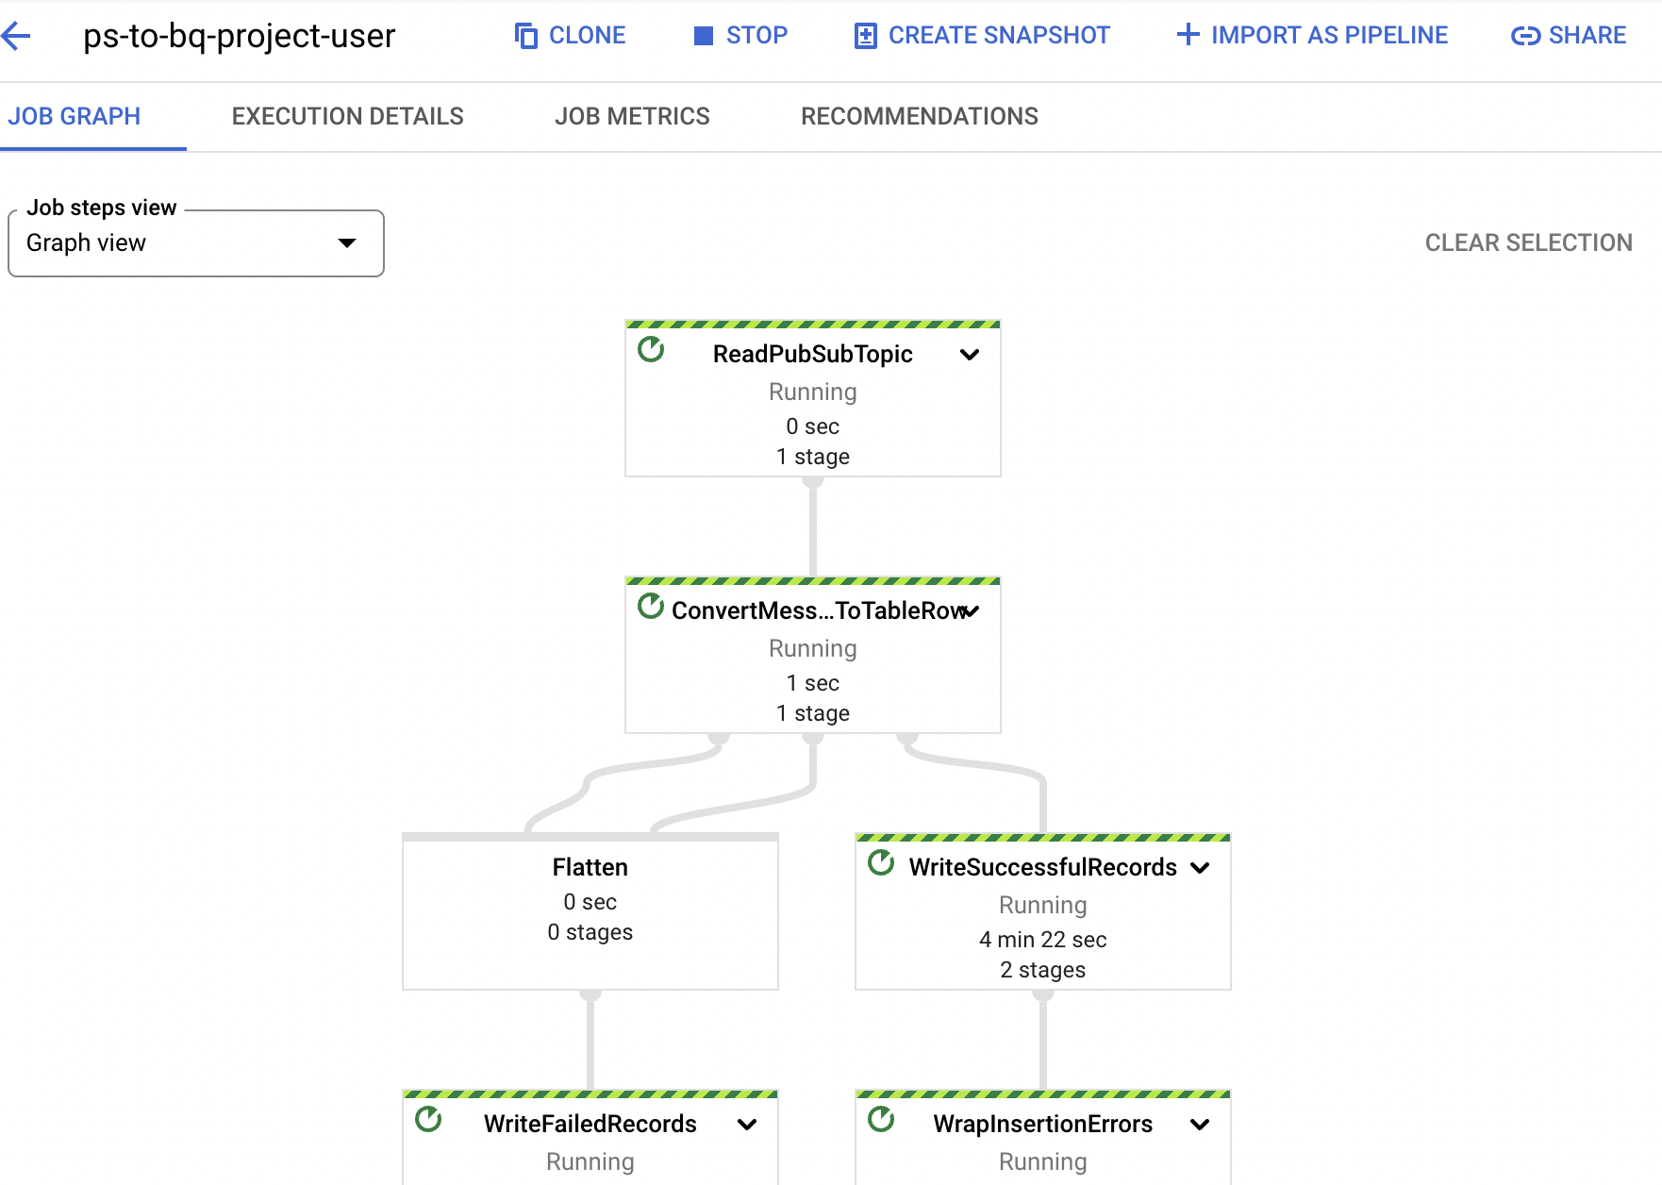
Pub-Sub

Slide 23
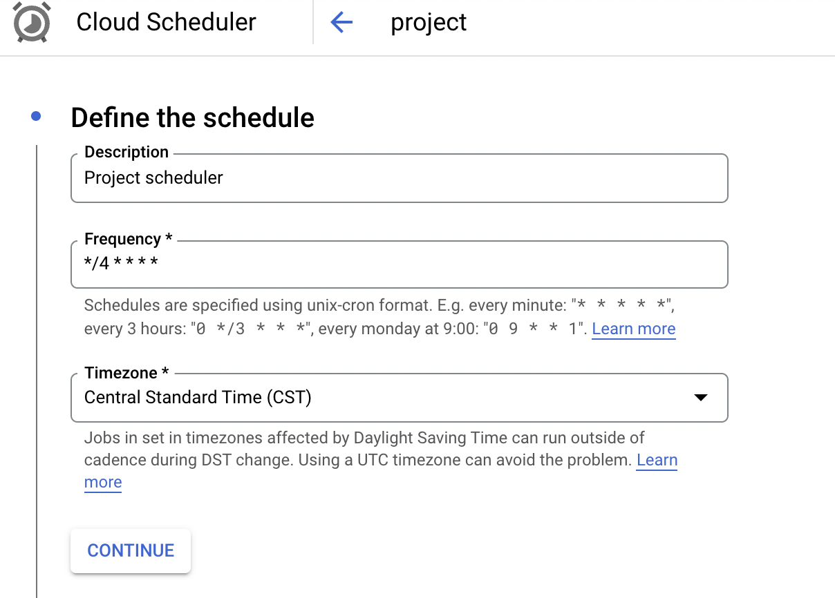
Cloud Schedular

Slide 24
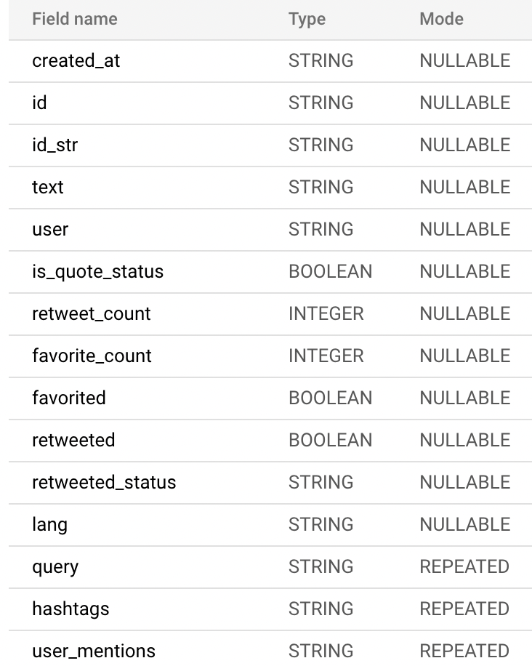
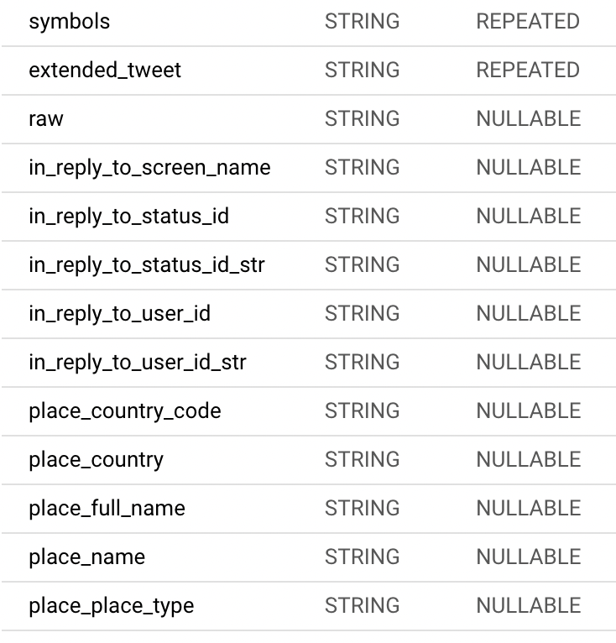
BQ Table Schema-Tweets

Slide 25
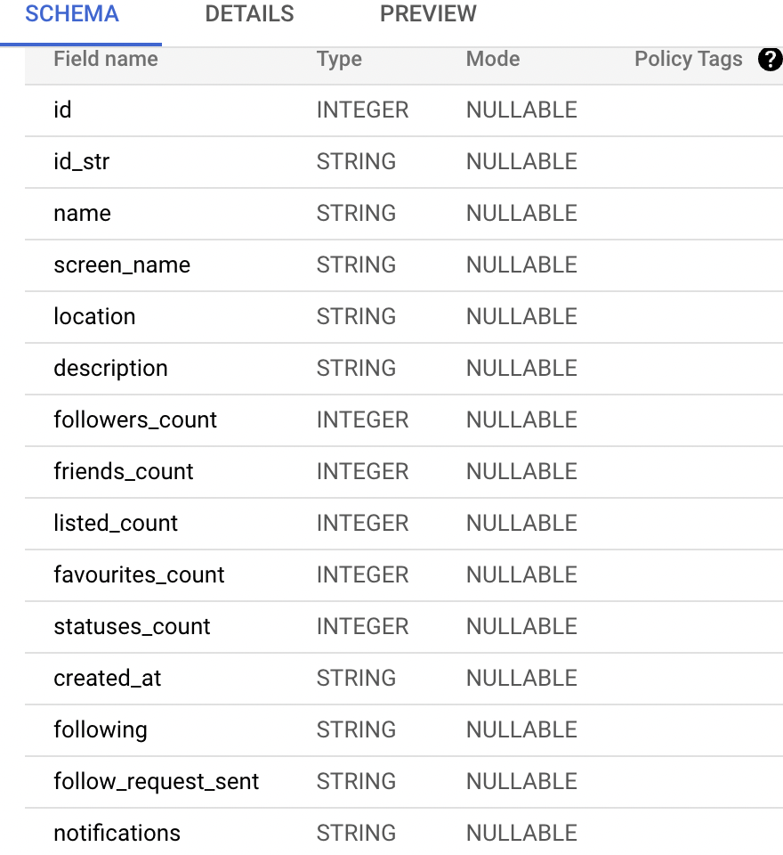
BQ Table Schema-Users

Slide 26
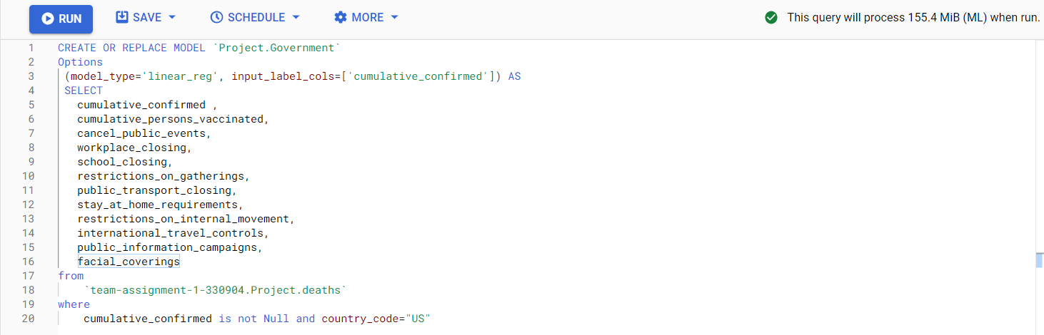
Effectiveness of Government Measures-Model

Slide 27
Effectiveness of Government Measures-Model
CREATE OR REPLACE MODEL `Project.Government`
Options
(model_type='linear_reg', input_label_cols=['cumulative_confirmed']) AS
SELECT
cumulative_confirmed ,
cumulative_persons_vaccinated,
cancel_public_events,
workplace_closing,
school_closing,
restrictions_on_gatherings,
public_transport_closing,
stay_at_home_requirements,
restrictions_on_internal_movement,
international_travel_controls,
public_information_campaigns,
facial_coverings
from
`team-assignment-1-330904.Project.deaths`
where
cumulative_confirmed is not Null and country_code="US"

Slide 28
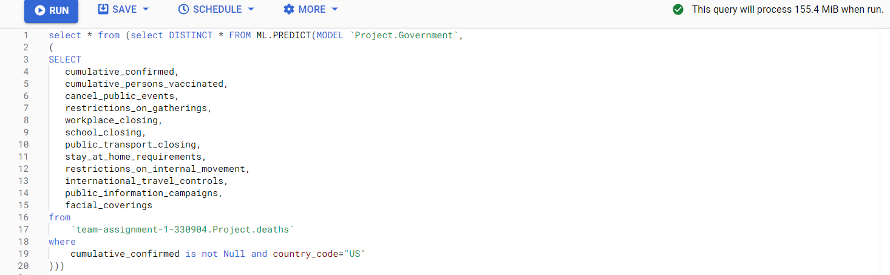
Effectiveness of Government Measures-Model

Slide 29
Effectiveness of Government Measures-Model
select * from (select DISTINCT * FROM ML.PREDICT(MODEL `Project.Government`,
(
SELECT
cumulative_confirmed,
cumulative_persons_vaccinated,
cancel_public_events,
restrictions_on_gatherings,
workplace_closing,
school_closing,
public_transport_closing,
stay_at_home_requirements,
restrictions_on_internal_movement,
international_travel_controls,
public_information_campaigns,
facial_coverings
from
`team-assignment-1-330904.Project.deaths`
where
cumulative_confirmed is not Null and country_code="US"
)))

Slide 30
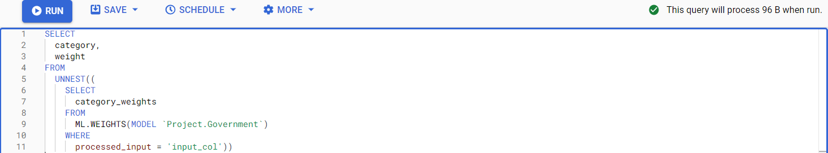
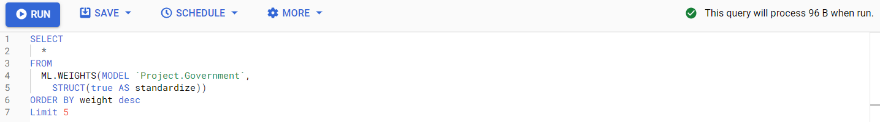
Weight Calculation-Model

Slide 31
Weight Calculation-Model
Query - Effective Weight Calculation
SELECT category, weight
FROM
UNNEST((SELECT category_weights
FROM ML.WEIGHTS(MODEL `Project.Government`)
WHERE processed_input = 'input_col'))
SELECT *
FROMML.WEIGHTS(MODEL `Project.Government`,STRUCT(true AS standardize))
ORDER BY weight desc
Limit 5

Slide 32
Weight Calculation-Result

Slide 33
Weight Calculation-Result
Query Result

Slide 34
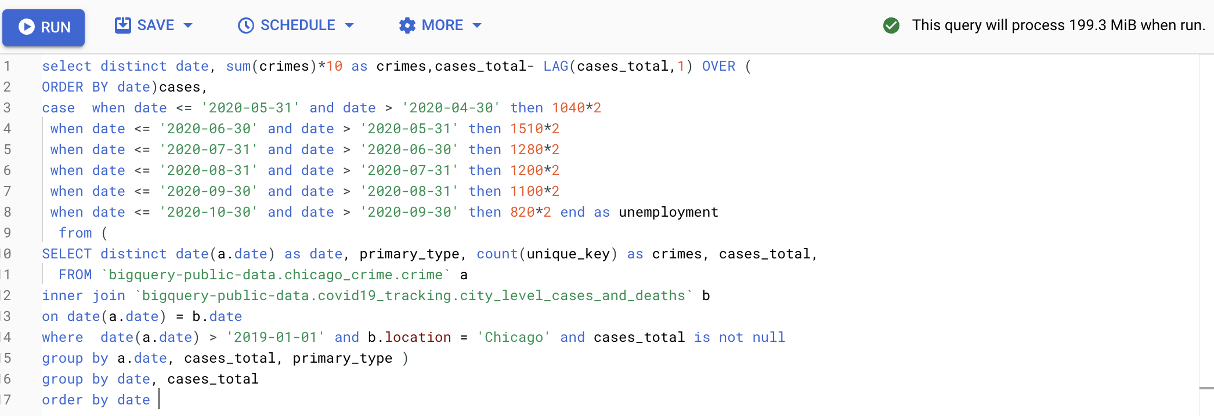
Relationship between Covid, Crime and Unemployment-Query

Slide 35
Relationship between Covid, Crime and Unemployment-Query
select distinct date, sum(crimes)*10 as crimes,cases_total- LAG(cases_total,1) OVER ( ORDER BY date)cases, case when date <= '2020-05-31' and date > '2020-04-30' then 1040*2 when date <= '2020-06-30' and date > '2020-05-31' then 1510*2 when date <= '2020-07-31' and date > '2020-06-30' then 1280*2 when date <= '2020-08-31' and date > '2020-07-31' then 1200*2 when date <= '2020-09-30' and date > '2020-08-31' then 1100*2 when date <= '2020-10-30' and date > '2020-09-30' then 820*2 end as unemployment from ( SELECT distinct date(a.date) as date, primary_type, count(unique_key) as crimes, cases_total, FROM `bigquery-public-data.chicago_crime.crime` a inner join `bigquery-public-data.covid19_tracking.city_level_cases_and_deaths` b on date(a.date) = b.date where date(a.date) > '2019-01-01' and b.location = 'Chicago' and cases_total is not null group by a.date, cases_total, primary_type ) group by date, cases_total order by date

Slide 36
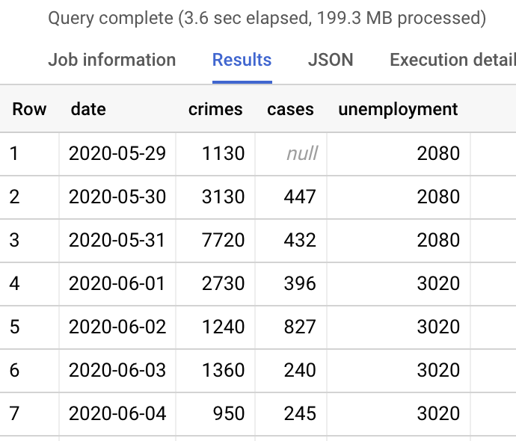
Relationship between Covid, Crime and Unemployment-Result

Slide 37
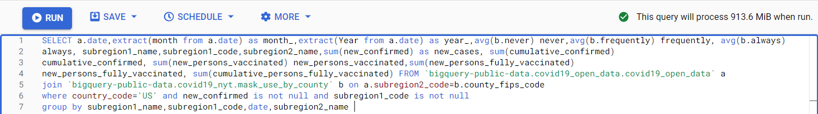
Usage of Masks County Wise- Query

Slide 38
Usage of Masks County Wise- Query
SELECT a.date,extract(month from a.date) as month_,extract(Year from a.date) as year_,avg(b.never) never,avg(b.frequently) frequently, avg(b.always)
always, subregion1_name,subregion1_code,subregion2_name,sum(new_confirmed) as new_cases, sum(cumulative_confirmed)
cumulative_confirmed, sum(new_persons_vaccinated) new_persons_vaccinated,sum(new_persons_fully_vaccinated)
new_persons_fully_vaccinated, sum(cumulative_persons_fully_vaccinated) FROM `bigquery-public-data.covid19_open_data.covid19_open_data` a
join `bigquery-public-data.covid19_nyt.mask_use_by_county` b on a.subregion2_code=b.county_fips_code
where country_code='US' and new_confirmed is not null and subregion1_code is not null
group by subregion1_name,subregion1_code,date,subregion2_name

Slide 39
Query Results
Query Result

Slide 40
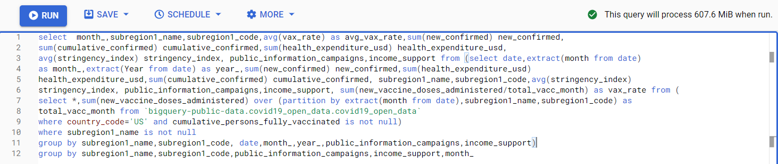
Factors Affecting Vaccination Rates- Query

Slide 41
Factors Affecting Vaccination Rates- Query
select month_,subregion1_name,subregion1_code,avg(vax_rate) as avg_vax_rate,sum(new_confirmed) new_confirmed,
sum(cumulative_confirmed) cumulative_confirmed,sum(health_expenditure_usd) health_expenditure_usd,
avg(stringency_index) stringency_index, public_information_campaigns,income_support from (select date,extract(month from date)
as month_,extract(Year from date) as year_,sum(new_confirmed) new_confirmed,sum(health_expenditure_usd)
health_expenditure_usd,sum(cumulative_confirmed) cumulative_confirmed, subregion1_name,subregion1_code,avg(stringency_index)
stringency_index, public_information_campaigns,income_support, sum(new_vaccine_doses_administered/total_vacc_month) as vax_rate from (
select *,sum(new_vaccine_doses_administered) over (partition by extract(month from date),subregion1_name,subregion1_code) as
total_vacc_month from `bigquery-public-data.covid19_open_data.covid19_open_data`
where country_code='US' and cumulative_persons_fully_vaccinated is not null)
where subregion1_name is not null
group by subregion1_name,subregion1_code, date,month_,year_,public_information_campaigns,income_support)
group by subregion1_name,subregion1_code,public_information_campaigns,income_support,month_

Slide 42
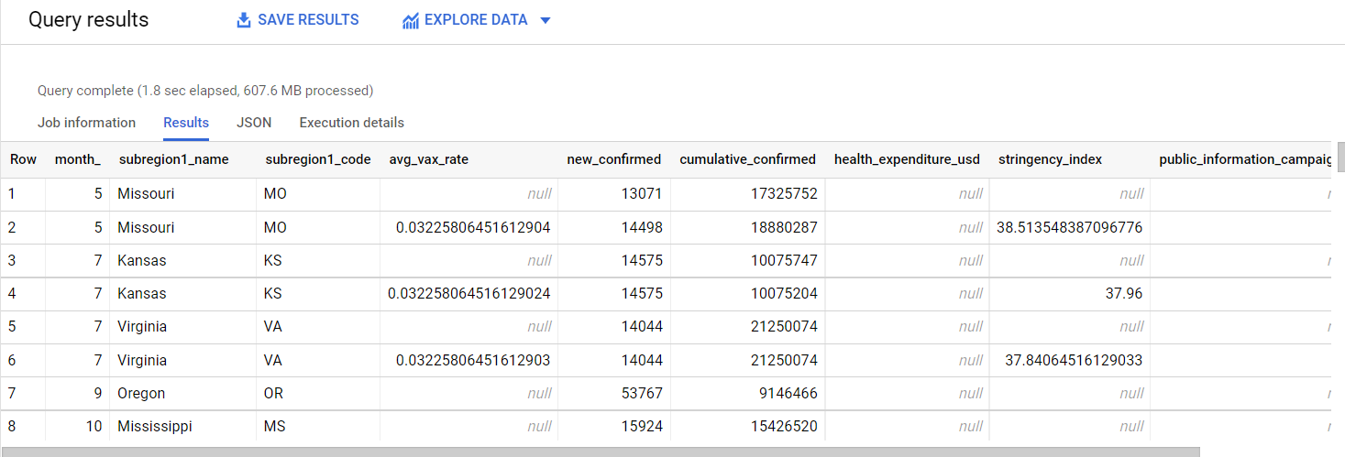
Query Results
Query Result

Slide 43
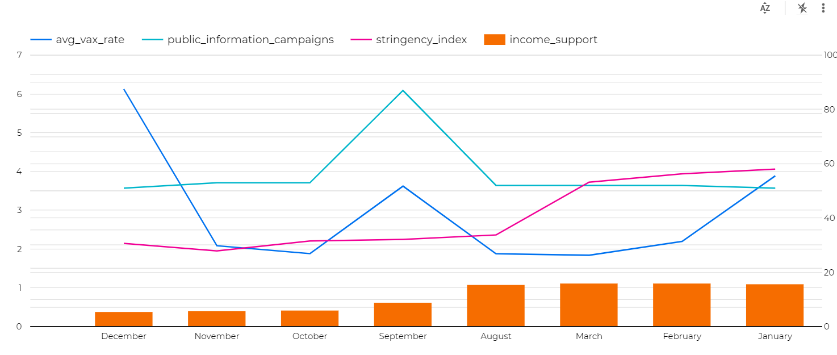
Query Results
Query Result

Slide 44
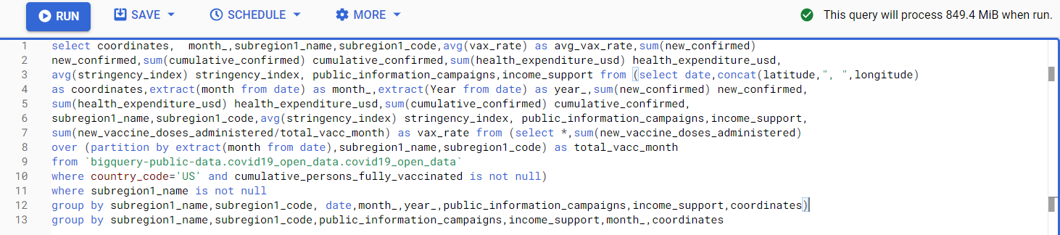
Covid Cases and Vaccination Rate Comparison - Query

Slide 45
Covid Cases and Vaccination Rate Comparison - Query
select coordinates, month_,subregion1_name,subregion1_code,avg(vax_rate) as avg_vax_rate,sum(new_confirmed)
new_confirmed,sum(cumulative_confirmed) cumulative_confirmed,sum(health_expenditure_usd) health_expenditure_usd,
avg(stringency_index) stringency_index, public_information_campaigns,income_support from (select date,concat(latitude,", ",longitude)
as coordinates,extract(month from date) as month_,extract(Year from date) as year_,sum(new_confirmed) new_confirmed,
sum(health_expenditure_usd) health_expenditure_usd,sum(cumulative_confirmed) cumulative_confirmed,
subregion1_name,subregion1_code,avg(stringency_index) stringency_index, public_information_campaigns,income_support,
sum(new_vaccine_doses_administered/total_vacc_month) as vax_rate from (select *,sum(new_vaccine_doses_administered)
over (partition by extract(month from date),subregion1_name,subregion1_code) as total_vacc_month
from `bigquery-public-data.covid19_open_data.covid19_open_data`
where country_code='US' and cumulative_persons_fully_vaccinated is not null)
where subregion1_name is not null
group by subregion1_name,subregion1_code, date,month_,year_,public_information_campaigns,income_support,coordinates)
group by subregion1_name,subregion1_code,public_information_campaigns,income_support,month_,coordinates
This Photo by Unknown Author is licensed under CC BY-NC
This Photo by Unknown Author is licensed under CC BY-NC

Slide 46
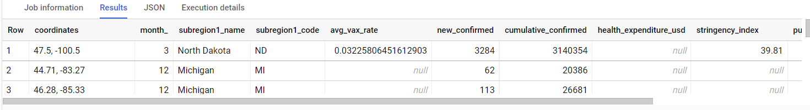
Covid Cases and Vaccination Rate Comparison - Result

Slide 47
Query Results

Slide 48
Relationship between Covid, crime and unemployment

Slide 49
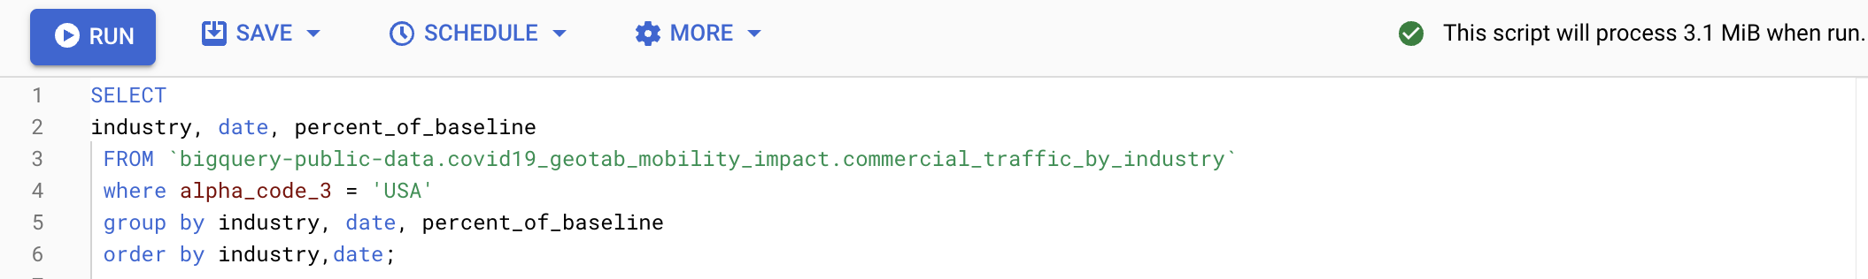
Impact on Industry-Query

Slide 50
Impact on Industry-Query
SELECT industry, date, percent_of_baseline FROM `bigquery-public-data.covid19_geotab_mobility_impact.commercial_traffic_by_industry` where alpha_code_3 = 'USA' group by industry, date, percent_of_baseline order by industry,date;

Slide 51
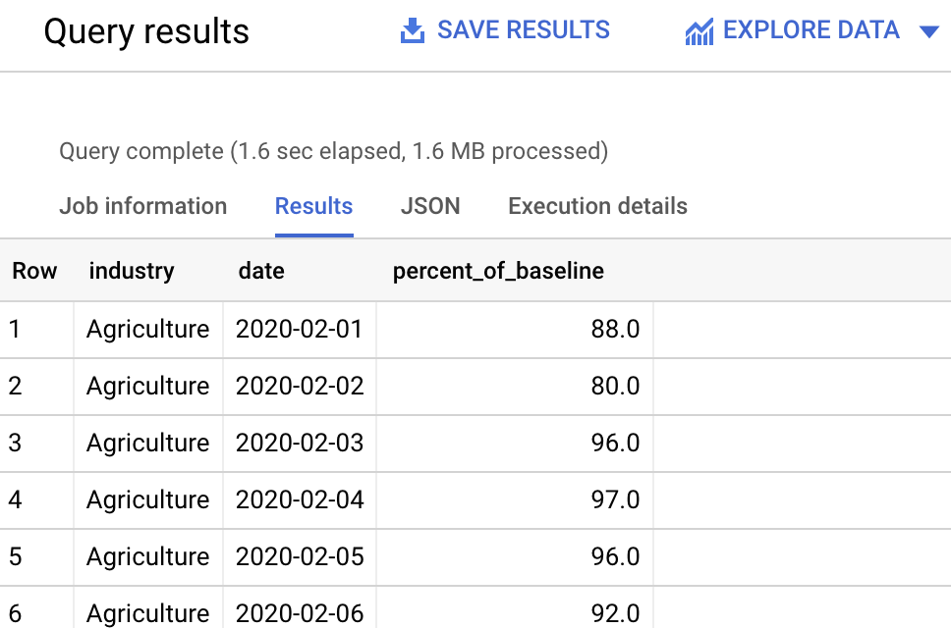
Query Results

Slide 52
Query Results

Slide 53
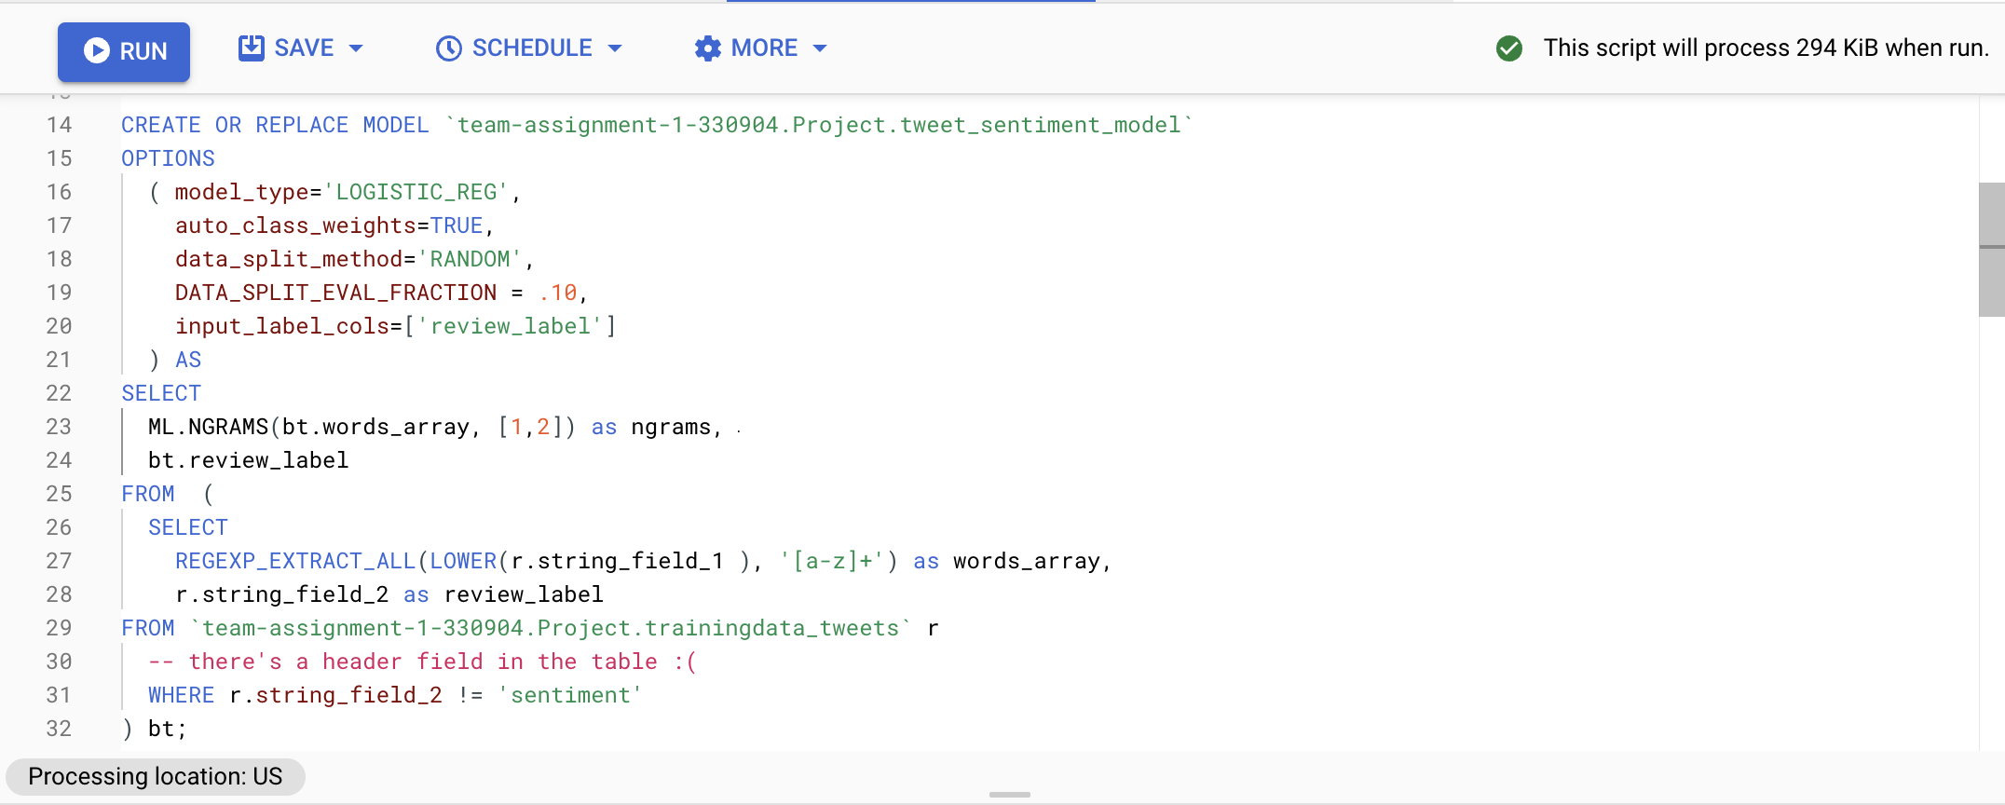
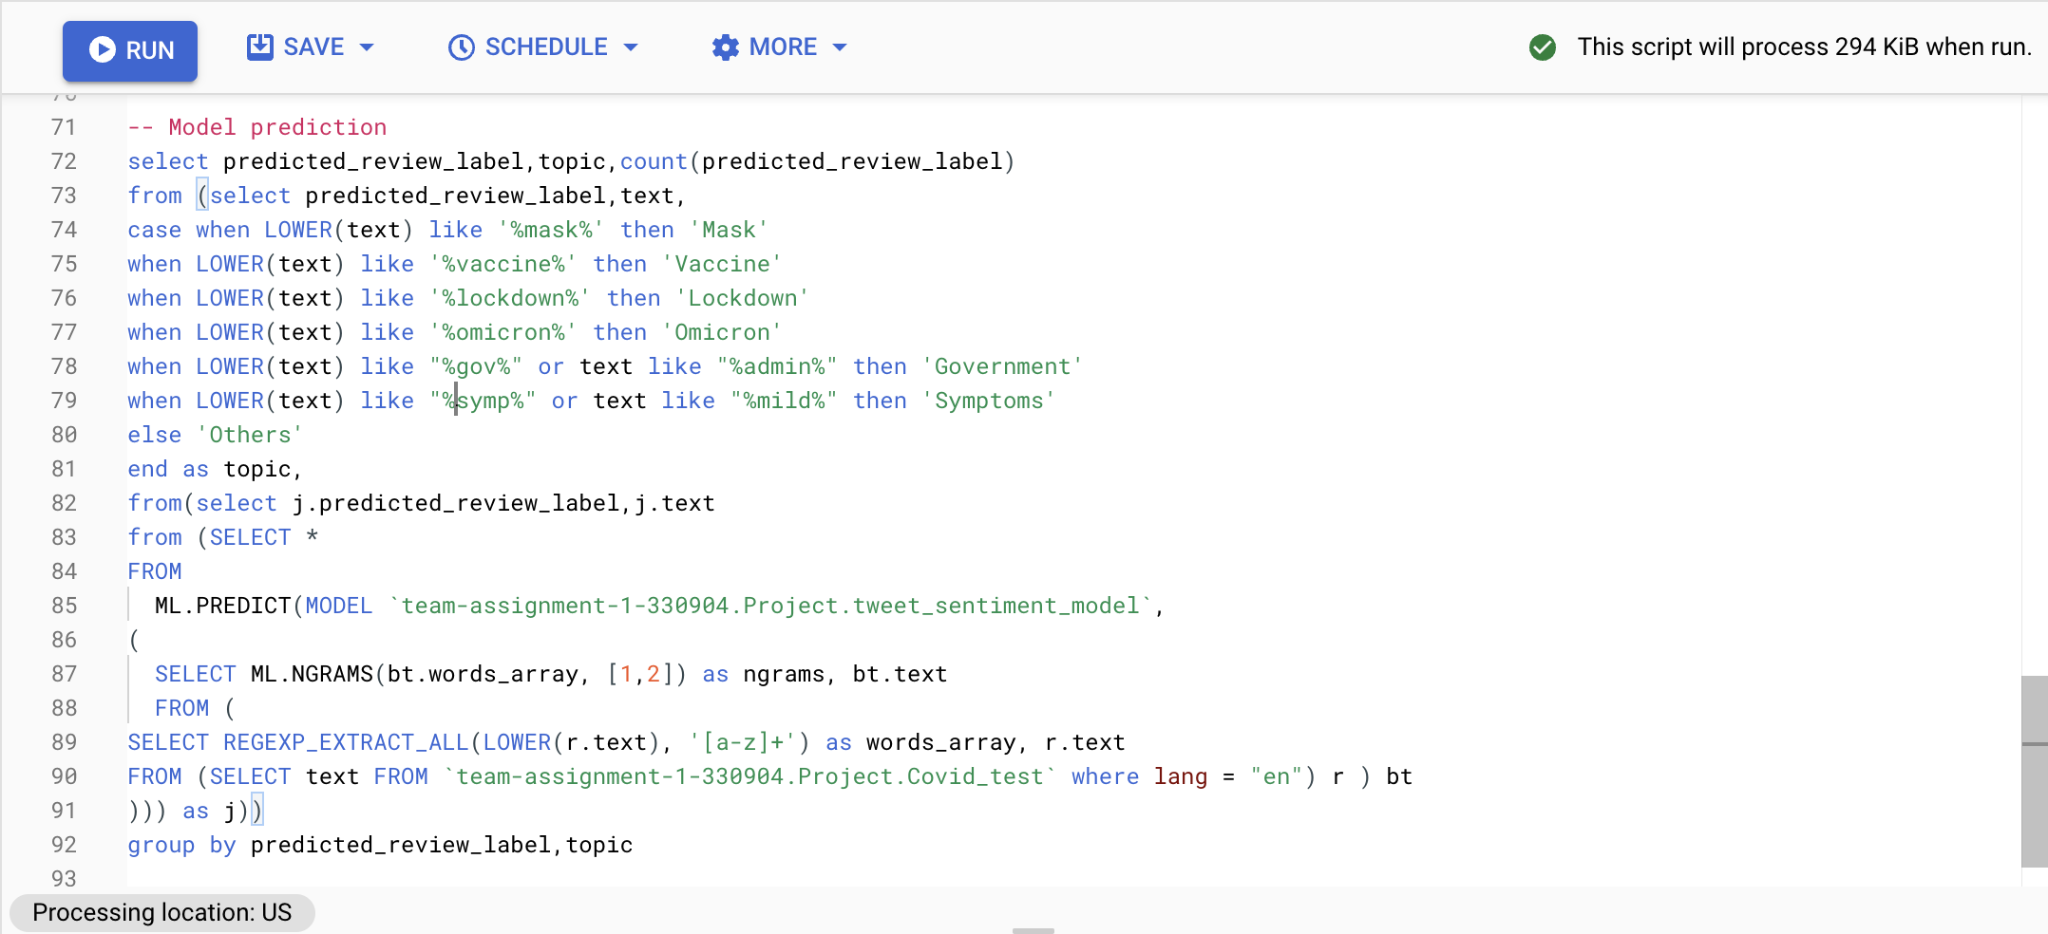
Sentiment Analysis-Query
Sentiment Analysis

Slide 54
Sentiment Analysis-Query
Sentiment Analysis
select distinct predicted_review_label,text,
case when LOWER(text) like '%mask%' then 'Mask'
when LOWER(text) like '%vaccine%' then 'Vaccine'
when LOWER(text) like '%lockdown%' then 'Lockdown'
when LOWER(text) like '%omicron%' then 'Omicron'
when LOWER(text) like "%gov%" or text like "%admin%" then 'Government'
when LOWER(text) like "%symp%" or text like "%mild%" then 'Symptoms'
else 'Others'
end as topic,
from(select j.predicted_review_label,j.text
from (SELECT *
FROM
ML.PREDICT(MODEL `team-assignment-1-330904.Project.tweet_sentiment_model`,
(
SELECT ML.NGRAMS(bt.words_array, [1,2]) as ngrams, bt.text
FROM (
SELECT REGEXP_EXTRACT_ALL(LOWER(r.text), '[a-z]+') as words_array, r.text
FROM (SELECT text FROM `team-assignment-1-330904.Project.Covid_test` where lang = "en") r ) bt
))) as j);

Slide 55
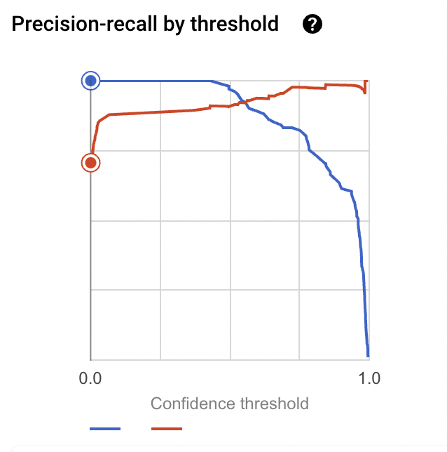
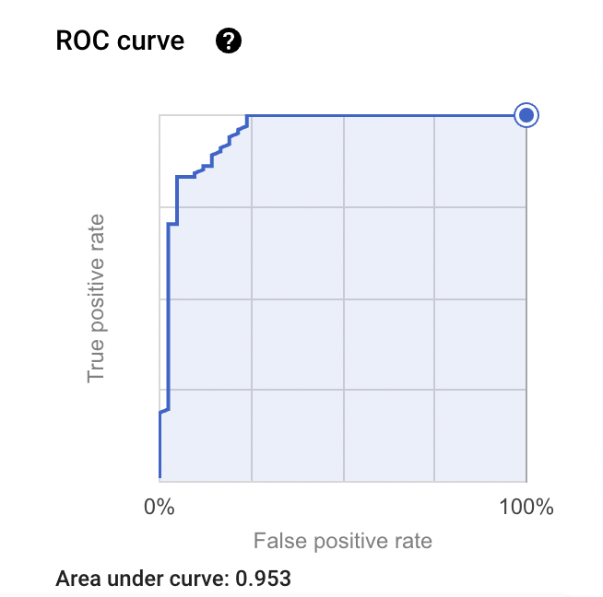
Sentiment Analysis–Model Analysis
Sentiment Analysis

Slide 56
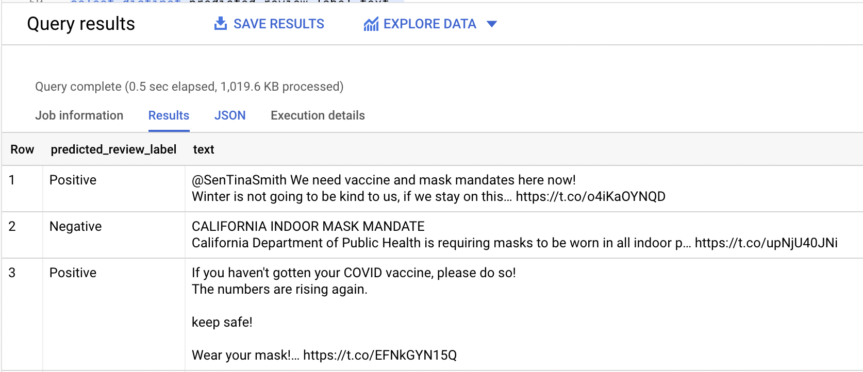
Sentiment Analysis
Query Results

Slide 57
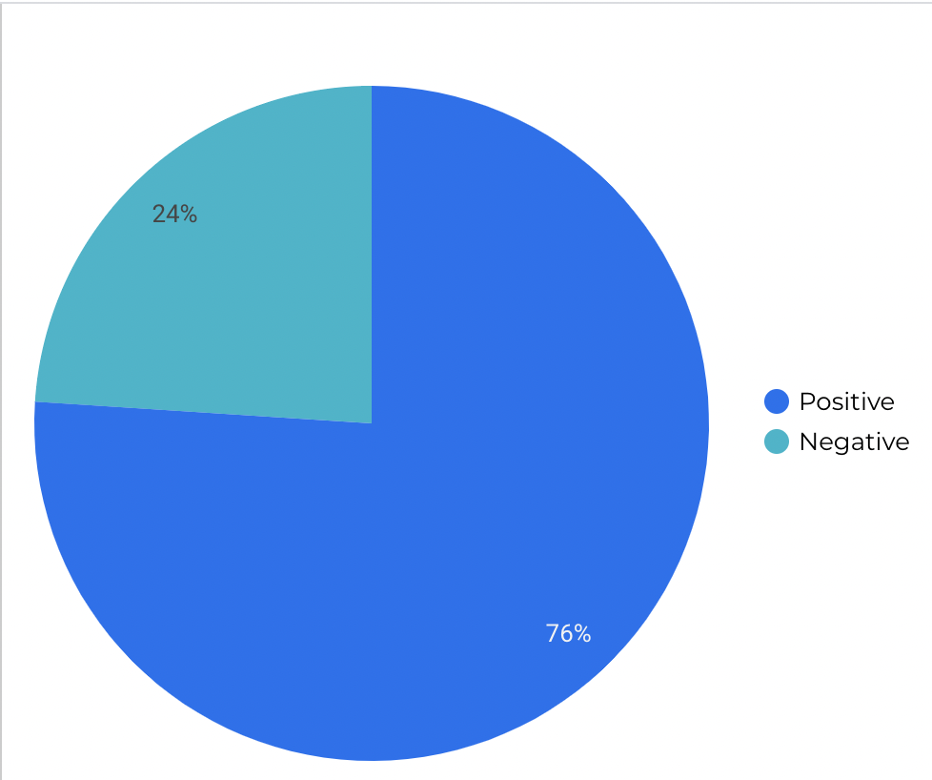
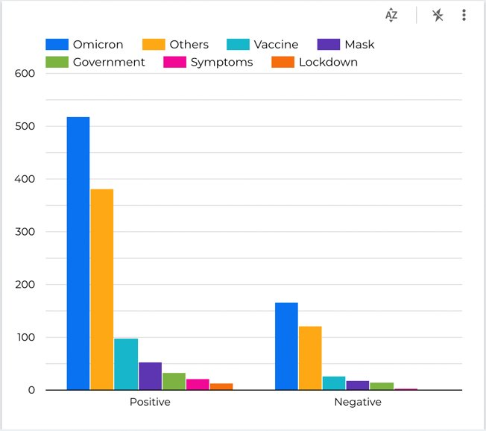
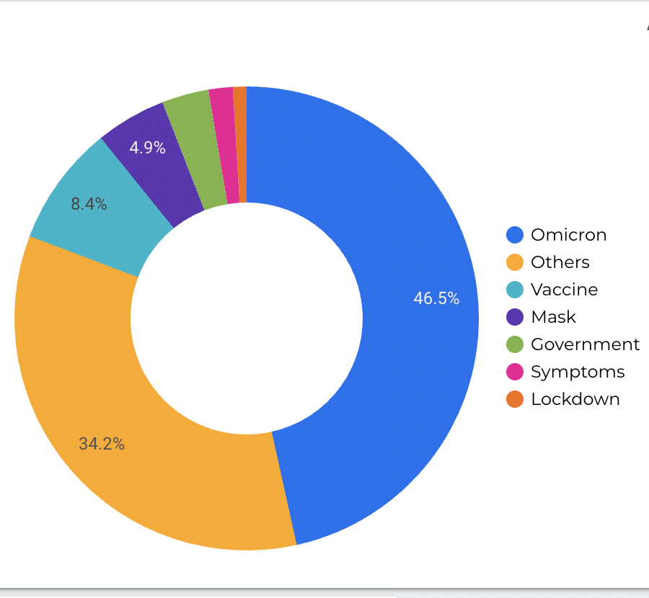
Sentiment Analysis
Query Results

